Slide 1
Memory Hierarchy
60080013: Computer Organization
6th Lecture, 2022
Instructors:
Sun Heng

Slide 2
Random-Access Memory (RAM)
局部性
Key features
  RAM is traditionally packaged as a chip.
  Basic storage unit is normally a cell (one bit per cell).
  Multiple RAM chips form a memory.
RAM comes in two varieties:
  SRAM (Static RAM)
  DRAM (Dynamic RAM)
Cache 缓存
Main memory 主存or 显存

Slide 3
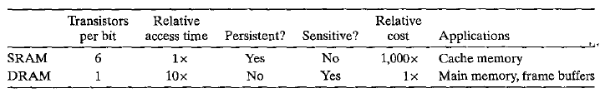
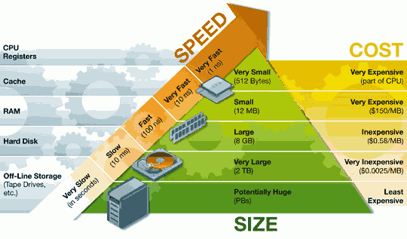
SRAM vs DRAM Summary
SRAM性能强，价格贵，容量有限
DRAM便宜，容量大，用来做主存

Slide 4
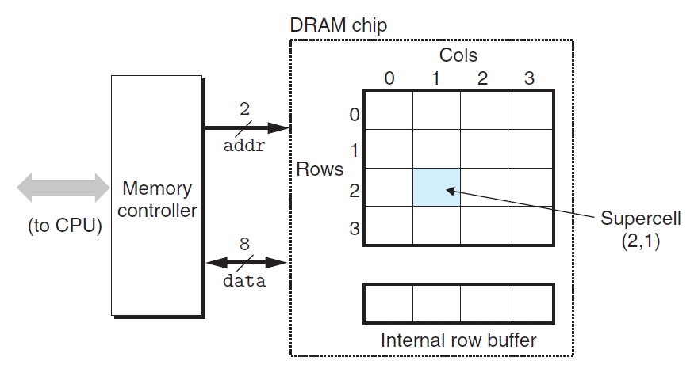


Conventional DRAMs
IMPORTANT FIGURE
引脚 pin（每个pin只能传输一位）
对于此chip只能存储16字节（4*4 supercell）
一次只能传入列或者行的信息
存储8位信息（Supercell）
内存逻辑地址翻译成真正位置

Slide 5
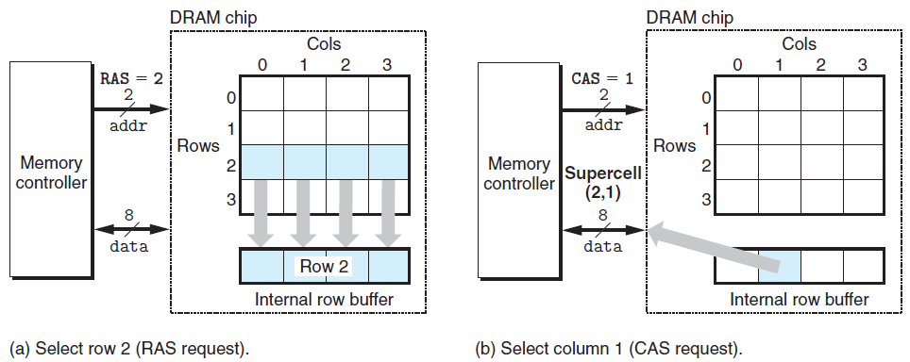
Conventional DRAMs

Slide 6
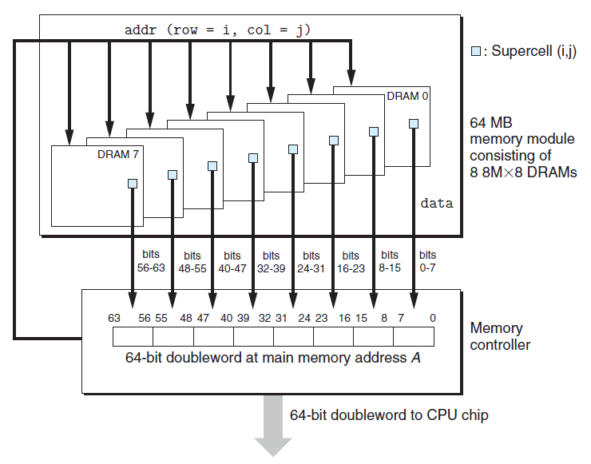
Memory Modules
有一个chip坏了就寄，需要一起读取（与disk不同 disk可以标注出错点并继续使用）
八个chip
借助每块chip的地址引脚，分配行号列号

Slide 7
Enhanced DRAMs
Basic DRAM cell has not changed since its invention in 1966.
  Commercialized by Intel in 1970.
DRAM cores with better interface logic and faster I/O :
  Synchronous DRAM (SDRAM)
    Uses a conventional clock signal instead of asynchronous control
    Allows reuse of the row addresses
  Double data-rate synchronous DRAM (DDR SDRAM)
    Double edge clocking sends two bits per cycle per pin
    Different types distinguished by size of small prefetch buffer:
      DDR (2 bits), DDR2 (4 bits), DDR3 (8 bits) , DDR4 (8 bits ) , DDR5 (16 bits)
    By 2010, standard for most server and desktop systems
    SKhynix releases the first DDR5 memory in October, 2020.
缓冲区大小变化

Slide 8
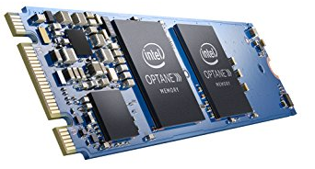
Nonvolatile Memories
不考非易失性存储器
DRAM and SRAM are volatile memories
  Lose information if powered off.
Nonvolatile memories retain value even if powered off
  Read-only memory (ROM): programmed during production
  Programmable ROM (PROM): can be programmed once
  Eraseable PROM (EPROM): can be bulk erased (UV, X-Ray)
  Electrically eraseable PROM (EEPROM): electronic erase capability
  Flash memory: EEPROMs, with partial (block-level) erase capability
    Wears out after about 100,000 erasings
  3D XPoint (Intel Optane) & emerging NVMs
    New materials
Uses for Nonvolatile Memories
  Firmware programs stored in a ROM (BIOS, controllers for disks, network cards, graphics accelerators, security subsystems,…)
  Solid state disks (replace rotating disks in thumb drives, smart phones, mp3 players, tablets, laptops, data centers,…)
  Disk caches

Slide 9
Traditional Bus Structure Connecting
CPU and Memory
A bus is a collection of parallel wires that carry address, data, and control signals.
Buses are typically shared by multiple devices.
CPU chip
Register file
ALU
System bus
Memory bus
Main
memory
Bus interface
I/O
bridge

Slide 10
Memory Read Transaction (1)
CPU places address A on the memory bus.
Register file
Load operation: movq A, %rax
ALU
%rax
Main memory
I/O bridge
A
0
Bus interface
x
A

Slide 11
Memory Read Transaction (2)
Main memory reads A from the memory bus, retrieves word x, and places it on the bus.
Register file
Load operation: movq A, %rax
ALU
%rax
Main memory
I/O bridge
x
0
Bus interface
x
A

Slide 12
Memory Read Transaction (3)
CPU read word x from the bus and copies it into register %eax.
Register file
Load operation: movq A, %rax
ALU
%rax
x
Main memory
I/O bridge
0
Bus interface
x
A

Slide 13
Memory Write Transaction (1)
CPU places address A on bus. Main memory reads it and waits for the corresponding data word to arrive.
Register file
Store operation: movq %rax, A
ALU
%rax
y
Main memory
I/O bridge
0
A
Bus interface
A

Slide 14
Memory Write Transaction (2)
CPU places data word y on the bus.
Register file
Store operation: movq %rax, A
ALU
%rax
y
Main memory
I/O bridge
y
0
Bus interface
A

Slide 15
Memory Write Transaction (3)
Main memory reads data word y from the bus and stores it at address A.
register file
Store operation: movq %rax, A
ALU
%rax
y
main memory
I/O bridge
0
bus interface
y
A

Slide 16
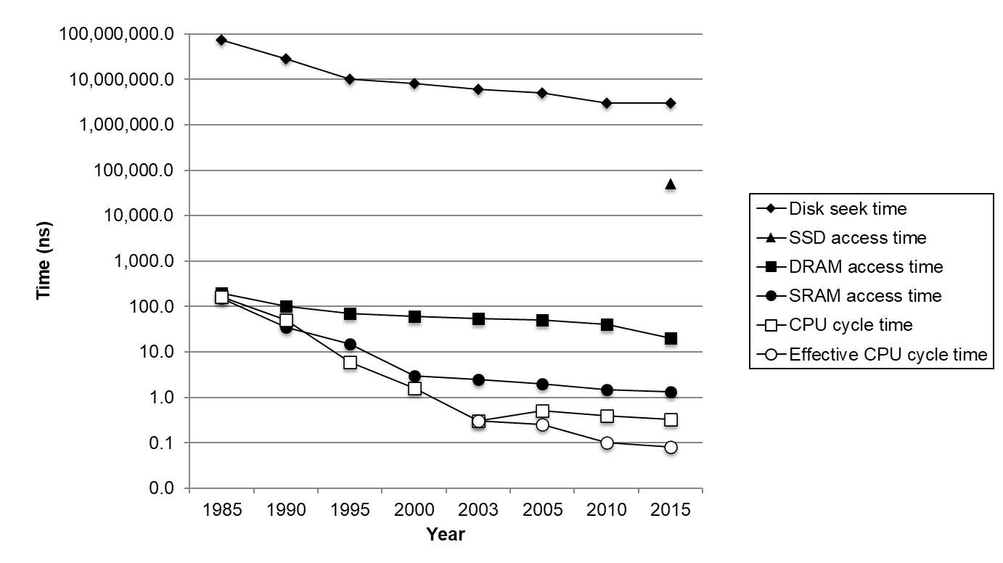
The CPU-Memory Gap
Disk
SSD
DRAM
CPU

Slide 17
Locality to the Rescue!
The key to bridging this CPU-Memory gap is a fundamental property of computer programs known as locality.

Slide 18

Locality
衡量程序局部性约等于衡量程序的性能好坏
IMPORTANT!!!!!!!!!
Principle of Locality: Programs tend to use data and instructions with addresses near or equal to those they have used recently
Temporal locality:
  Recently referenced items are likely
  to be referenced again in the near future
Spatial locality:
  Items with nearby addresses tend
  to be referenced close together in time
时间局部性：指令or数据有无被多次访问，多次使用到便为时间局部性很好
空间局部性：所有的访问次序是临近访问(访问完一个东西，继续访问它的邻居)

Slide 19

Locality Example
考虑两点：①数据的局部性②指令的局部性
sum = 0;
for (i = 0; i < n; i++)
sum += a[i];
return sum;
①累加器sum
②数组a[i]
Data references
  Reference array elements in succession (stride-1 reference pattern).
  Reference variable sum each iteration.
Instruction references
  Reference instructions in sequence.
  Cycle through loop repeatedly.
Spatial locality
Temporal locality
Spatial locality
Temporal locality

Slide 20
Qualitative Estimates of Locality
Claim: Being able to look at code and get a qualitative sense of its locality is a key skill for a professional programmer.
Question: Does this function have good locality with respect to array a?
int sumarrayrows(int a[M][N])
{
int i, j, sum = 0;
for (i = 0; i < M; i++)
for (j = 0; j < N; j++)
sum += a[i][j];
return sum;
}

Slide 21
Locality Example
Question: Does this function have good locality with respect to array a?
int sumarraycols(int a[M][N])
{
int i, j, sum = 0;
for (j = 0; j < N; j++)
for (i = 0; i < M; i++)
sum += a[i][j];
return sum;
}

Slide 22
Memory Hierarchies
Some fundamental and enduring properties of hardware and software:
  Fast storage technologies cost more per byte, have less capacity, and require more power (heat!).
  The gap between CPU and main memory speed is widening.
  Well-written programs tend to exhibit good locality.
These fundamental properties complement each other beautifully.
They suggest an approach for organizing memory and storage systems known as a memory hierarchy.

Slide 23
An Example Memory Hierarchy
L0:
CPU registers hold words retrieved from L1 cache
Registers
L1:
L1 cache
(SRAM)
Smaller,
faster,
costlier
per byte
L1 cache holds cache lines retrieved from L2 cache
L2:
L2 cache
(SRAM)
L2 cache holds cache lines retrieved from main memory
L3:
Larger,
slower,
cheaper
per byte
Main memory
(DRAM)
Main memory holds disk blocks retrieved from local disks
L4:
Local secondary storage
(local disks)
Local disks hold files retrieved from disks on remote network servers
Remote secondary storage
(tapes, distributed file systems, Web servers)
L5:

Slide 24
Caches
Cache: A smaller, faster storage device that acts as a staging area for a subset of the data in a larger, slower device.

Slide 25
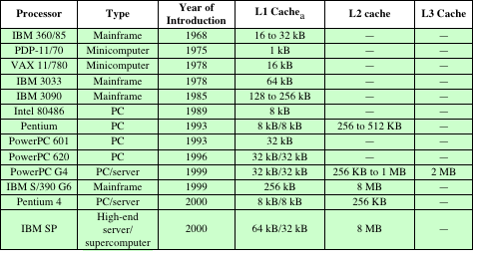
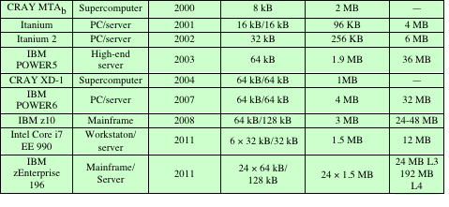
Cache Sizes of Some Processors
ª Two values separated by a slash refer to instruction and data caches.
^{b} Both caches are instruction only; no data caches.

Slide 26
General Cache Concepts
从这开始不考
Smaller, faster, more expensive
memory caches a subset of
the blocks
Cache
8
4
9
14
10
3
Data is copied in block-sized transfer units
4
10
Larger, slower, cheaper memory
viewed as partitioned into “blocks”
Memory
0
1
2
3
4
4
5
6
7
8
9
10
10
11
12
13
14
15

Slide 27
General Cache Concepts: Hit
如何用内存地址在缓存中找数据
Request: 14
Data in block d is needed
Cache
Block d is in cache:
Hit!
8
9
14
3
14
Memory
0
1
2
3
4
5
6
7
8
9
10
11
12
13
14
15

Slide 28
General Cache Concepts: Miss
Request: 12
Data in block d is needed
Cache
Block d is not in cache:
Miss!
8
9
14
3
12
Block d is fetched from
memory
12
Request: 12
Block d is stored in cache
Placement policy:
determines where d goes
Replacement policy:
determines which block
gets evicted (victim)
Memory
0
1
2
3
4
5
6
7
8
9
10
11
12
12
13
14
15

Slide 29
General Caching Concepts:
Types of Cache Misses
Cold (compulsory) miss
  Cold misses occur because the cache is empty.
Conflict miss
  Most caches limit blocks at level k+1 to a small subset (sometimes a singleton) of the block positions at level k.
    E.g. Block i at level k+1 must be placed in block (i mod 4) at level k.
  Conflict misses occur when the level k cache is large enough, but multiple data objects all map to the same level k block.
    E.g. Referencing blocks 0, 8, 0, 8, 0, 8, ... would miss every time.
Capacity miss
  Occurs when the set of active cache blocks (working set) is larger than the cache.

Slide 30
Cache Memories
Cache memories are small, fast SRAM-based memories managed automatically in hardware
  Hold frequently accessed blocks of main memory
CPU looks first for data in cache, then in main memory
Typical system structure:
CPU chip
Register file
ALU
Cache
memory
System bus
Memory bus
Main
memory
Bus interface
I/O
bridge

Slide 31
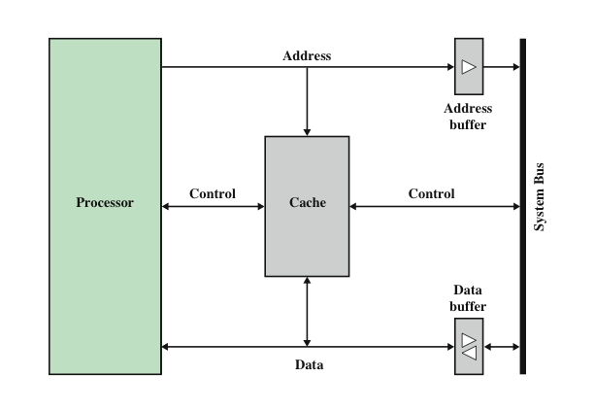
Typical Cache Organization

Slide 32
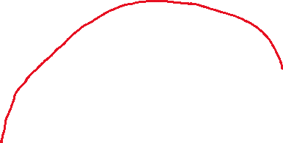
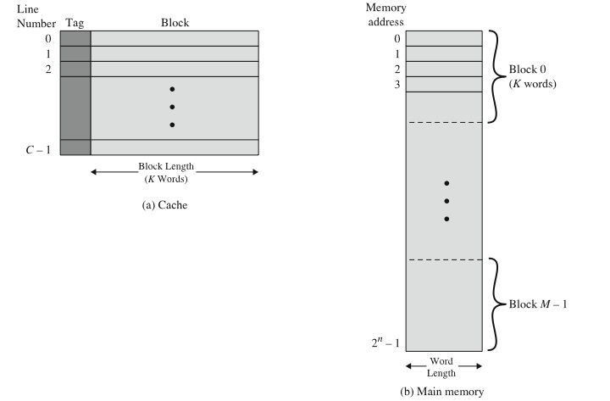


Cache/Main Memory Structure
大小相等

Slide 33
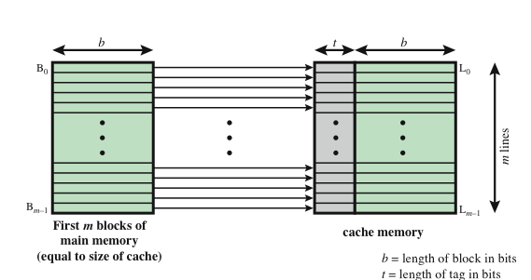
Direct Mapping

Slide 34
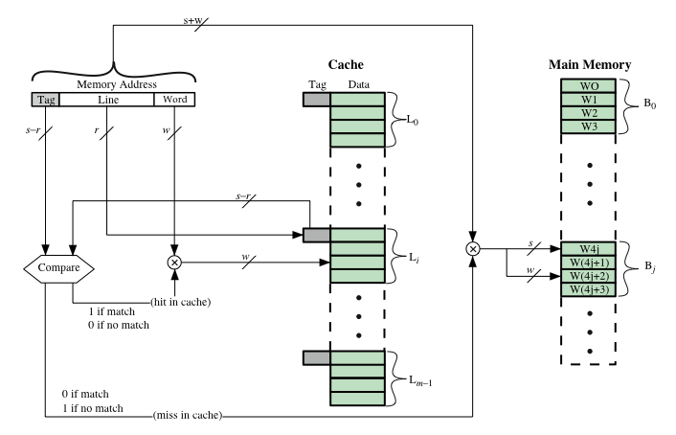
Direct Mapping Cache Organization

Slide 35
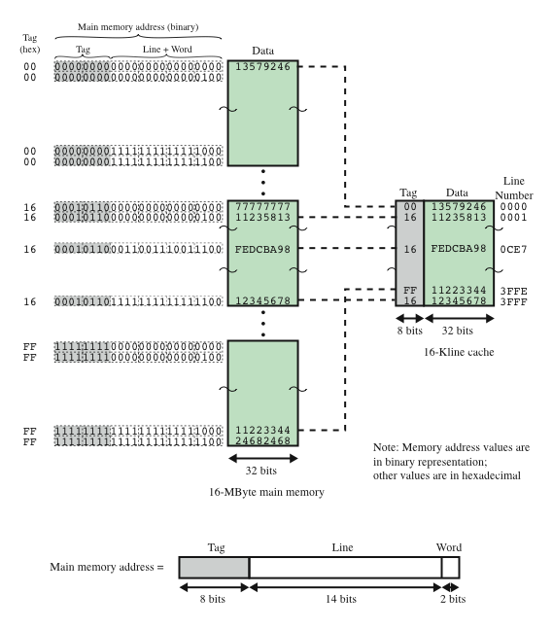
Direct
Mapping
Example

Slide 36

Direct Mapping Summary
Address length = (s + w) bits
Number of addressable units = 2^{s+w} words or bytes
Block size = line size = 2^{w} words or bytes
Number of blocks in main memory = 2^{s+ w}/2^{w} = 2^{s}
Number of lines in cache = m = 2^{r}
Size of tag = (s – r) bits

Slide 37
Magnetic Disk
A disk is a circular platter constructed of nonmagnetic material, called the substrate, coated with a magnetizable material
  Traditionally the substrate has been an aluminium or aluminium alloy material
  Recently glass substrates have been introduced
Benefits of the glass substrate:
  Improvement in the uniformity of the magnetic film surface to increase disk reliability
  A significant reduction in overall surface defects to help reduce read-write errors
  Ability to support lower fly heights
  Better stiffness to reduce disk dynamics
  Greater ability to withstand shock and damage

Slide 38
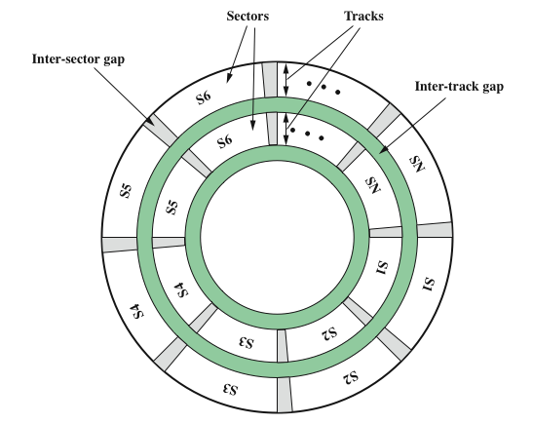
Disk Data Layout

Slide 39
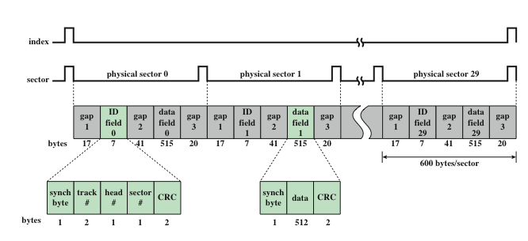
Winchester Disk Format
Seagate ST506

Slide 40
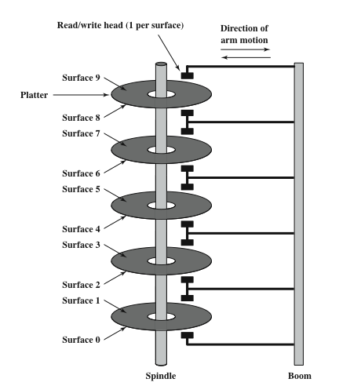
Multiple Platters

Slide 41
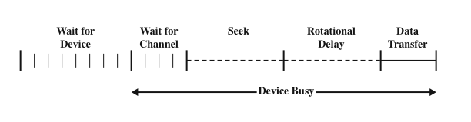
Timing of Disk I/O Transfer

Slide 42
Disk Performance Parameters
When the disk drive is operating the disk is rotating at constant speed
To read or write the head must be positioned at the desired track and at the beginning of the desired sector on the track
  Track selection involves moving the head in a movable-head system or electronically selecting one head on a fixed-head system
  Once the track is selected, the disk controller waits until the appropriate sector rotates to line up with the head
Seek time
  On a movable–head system, the time it takes to position the head at the track
Rotational delay (rotational latency)
  The time it takes for the beginning of the sector to reach the head
Access time
  The sum of the seek time and the rotational delay
  The time it takes to get into position to read or write
Transfer time
  Once the head is in position, the read or write operation is then performed as the sector moves under the head
  This is the data transfer portion of the operation

Slide 43
Seek Time
Seek time is the time required to move the disk arm to the required track. It turns out that this is a difficult quantity to pin down. The seek time consists of two key components: the initial startup time, and the time taken to traverse the tracks that have to be crossed once the access arm is up to speed. Unfortunately, the traversal time is not a linear function of the number of tracks, but includes a settling time (time after positioning the head over the target track until track identification is confirmed).
Much improvement comes from smaller and lighter disk components. Some years ago, a typical disk was 14 inches (36 cm) in diameter, whereas the most common size today is 3.5 inches (8.9 cm), reducing the distance that the arm has to travel. A typical average seek time on contemporary hard disks is under 10 ms.

Slide 44
Rotational Delay
Disks rotate at speeds ranging from 3600 rpm (for handheld devices such as digital cameras) up to, as of this writing, 20,000 rpm; at this latter speed, there is one revolution per 3 ms. Thus, on the average, the rotational delay will be 1.5 ms.

Slide 45


Transfer Time
The transfer time to or from the disk depends on the rotation speed of the disk in the following fashion:
where
T = transfer time
b = number of bytes to be transferred
N = number of bytes on a track
r = rotation speed, in revolutions per second
Thus the total average access time can be expressed as
where Ts is the average seek time. Note that on a zoned drive, the number of bytes per track is variable, complicating the calculation.

Slide 46
Timing Comparison
Look at two different I/O operations that illustrate the danger of relying on average values. Consider a disk with an advertised average seek time of 4 ms, rotation speed of 15,000 rpm, and 512-byte sectors with 500 sectors per track. Suppose that we wish to read a file consisting of 2500 sectors for a total of 1.28 Mbytes. We would like to estimate the total time for the transfer.

Slide 47
Sequential Organization
assume that the file is stored as compactly as possible on the disk. That is, the file occupies all of the sectors on 5 adjacent tracks (5 tracks * 500 sectors/track = 2500 sectors).
The time to read the first track is as follows:
Average seek 4 ms
Average rotational delay 2 ms
Read 500 sectors 4 ms
= 10 ms
Total time = 10 + (4 * 6) = 34 ms = 0.034 seconds

Slide 48
Random Organization
The sectors are distributed randomly over the disk:
Average seek 4 ms
Rotational delay 2 ms
Read 1 sectors 0.008 ms
6.008 ms
Total time = 2500 * 6.008 = 15,020 ms = 15.02 seconds

Slide 49
Classwork
Problem 6.8.

